Slide 1
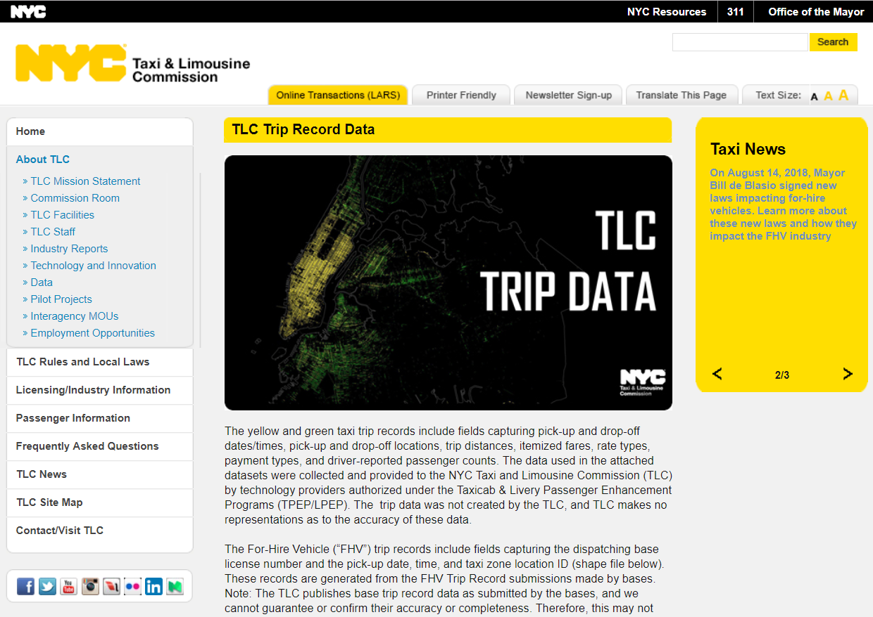
Executive Summary
Motivation – What got us going!
One of the key attraction towards the New York Cab dataset was the volume of the data.
Feature engineering was another key reason to take up this dataset.
Considering the volume of dataset it was essential that we adopt the right sampling methodology for the success of model.
The learning from this study can be applied to Metropolitan cities in India which would in turn help address the traffic congestion problem.
Also the challenge of adding geotags since Latitude and Longitudes were not available in the dataset, helped us explore the Google Map API.

Slide 2
Executive Summary
Method – Where were we heading?
Each Month the New York Cabs generate 800,000 KB data.
The Dataset consists of the following variables {VendorID, PU & Drop time, Number of Passengers, Trip Distance Rate Code ID, Store and Fwd Flag, Pick-up and Drop LocationID, Payment Type, Fare Amount, Extra, MTA Tax, Tip amount, Tolls amount, Improvement surcharge & Total Amount.}
To this dataset we added the following variables {Day of Pick-up & Drop, Pick-up and Drop Lat and Longitude, Duration of the Trip in Min}
We used the 3 Months data and between Random sampling and Stratified Sampling, we decided to take up stratified sampling. We drew proportion from Pick-up Location ID as it represents the volume of demand by zone at a given time.
We combined the 3 month sample dataset and allocated 70% for Training and 30% for Testing.

Slide 3
Executive Summary
Models How did we get there?
Means – How did we discovered this?
We made use of the following model in our analysis.
Markov Chain
Decision Tree
Network Analysis
Network Clustering
We used the following API and Packages to enable the analysis listed:
Google Map API,
Igraph
Nodes and Edge
Tkplot (interactive network graph)
Dendogram
Community Cluster
Markovchain
Rpart
Caret

Slide 4
Data analysis with a purpose

Slide 5
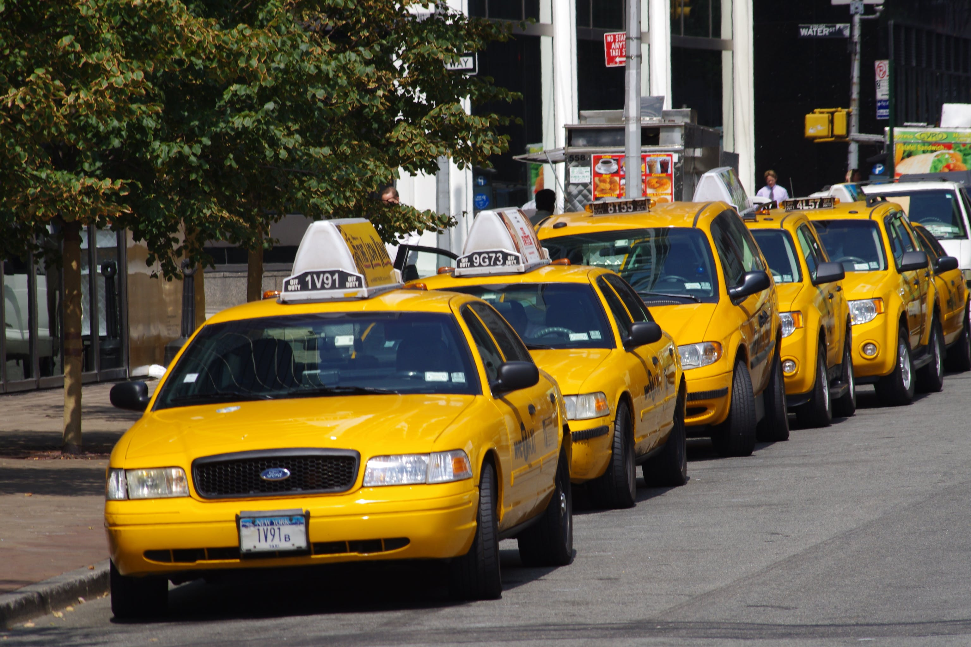
Business problem
Business Understanding
The objective is to optimize the network of New York cabs with 2 main outcome
Use of city cabs to reduce the congestions on the road
Better use the resources for the ever growing population in the city which is true for any metropolitan city.
The main stakeholders would new transportation company (since the NYC is a duopoly) and city planners.

Slide 6
Data Requirements & Collections
As mentioned in the briefing document we made use of the TLC cab data available on (http://www.nyc.gov/html/tlc/html/about/trip_record_data.shtml)
We used the 2018-04, 2018-05 & 2018-06.
We also downloaded the zone taxi blocks from the same website.
We imported maps and geo- coordinates from Google map and ggmap.
We combined these 3 database for our analysis.

Slide 7
Connecting the dots
Data understanding

Slide 8
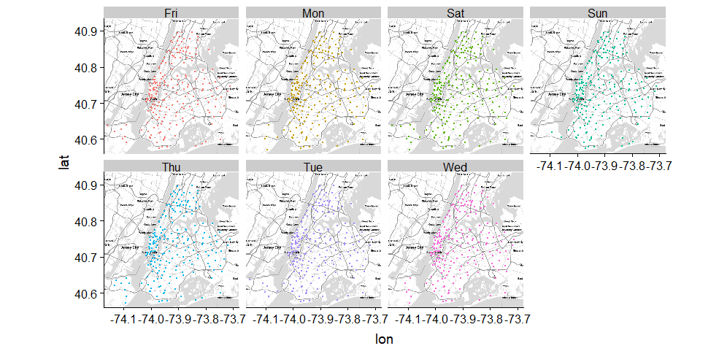
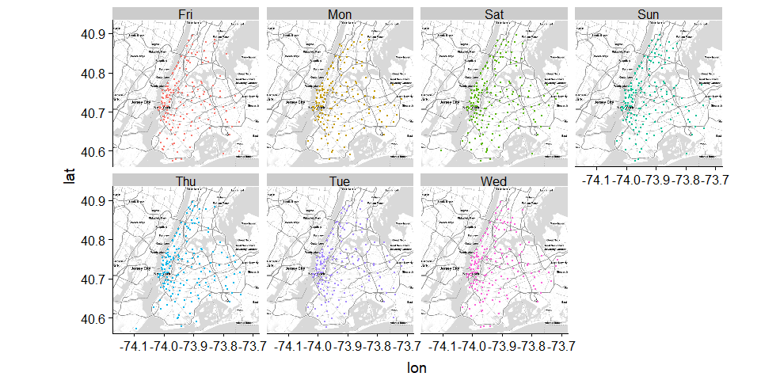
Data Understanding
On Monday and Tuesday the volume trips are the same relatively low in the beginning of the week. Mostly moving from Manhattan to Brooklyn
On Wednesday, Thursday & Friday the volume of trips increase vs. Monday – Tuesday.
Trips on Sat and Sunday increase more towards Bronx, followed by Brooklyn and State Island.
Drop-off
Pick-up

Slide 9
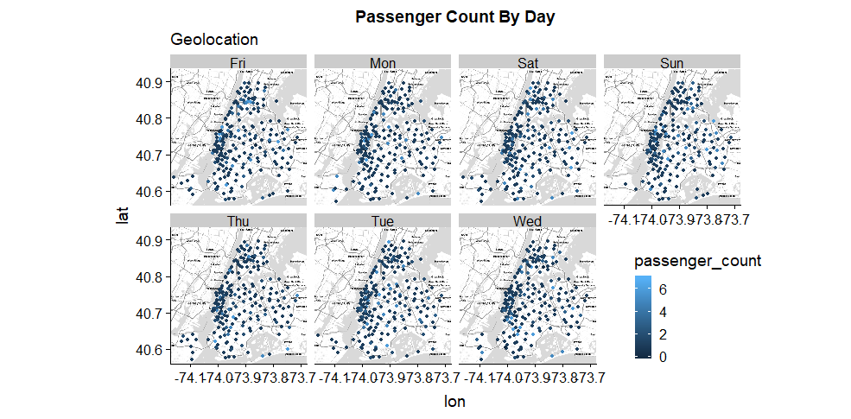
Data Understanding
On Monday most commuters are single passenger commuters.
On Tuesday the number of passenger increases particularly in Brooklyn zone (directed to product design).
More single commuters are travelling in NYC on Wednesday & Thursday increasing the volume on the roads.
As expected the number of commuters increase on Friday, Sat and Sun in each cab ride travelling to Bronx & Brooklyn (assuming they are friends & family travelling together)

Slide 10
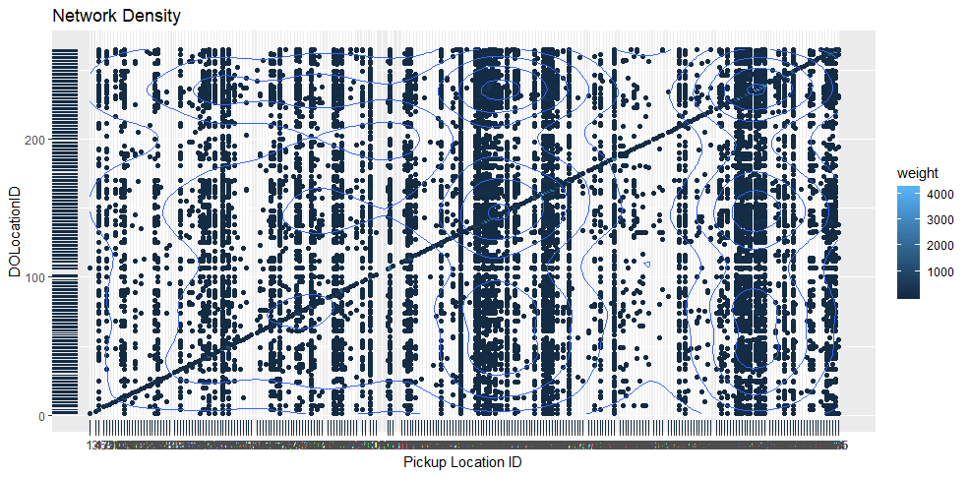
Data Understanding
In this density map indicates that a high volume of cab rides are happen within the same taxi zones.
The other high volume of commute is happening between Manhattan to Queens followed by Bronx and then Brooklyn and State Island being the least.

Slide 11
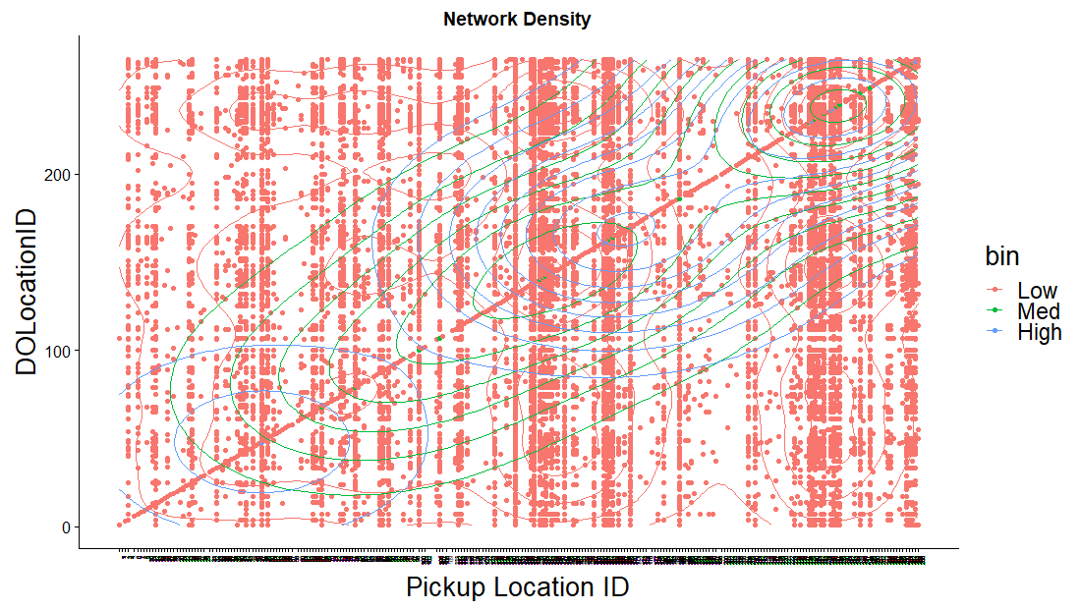
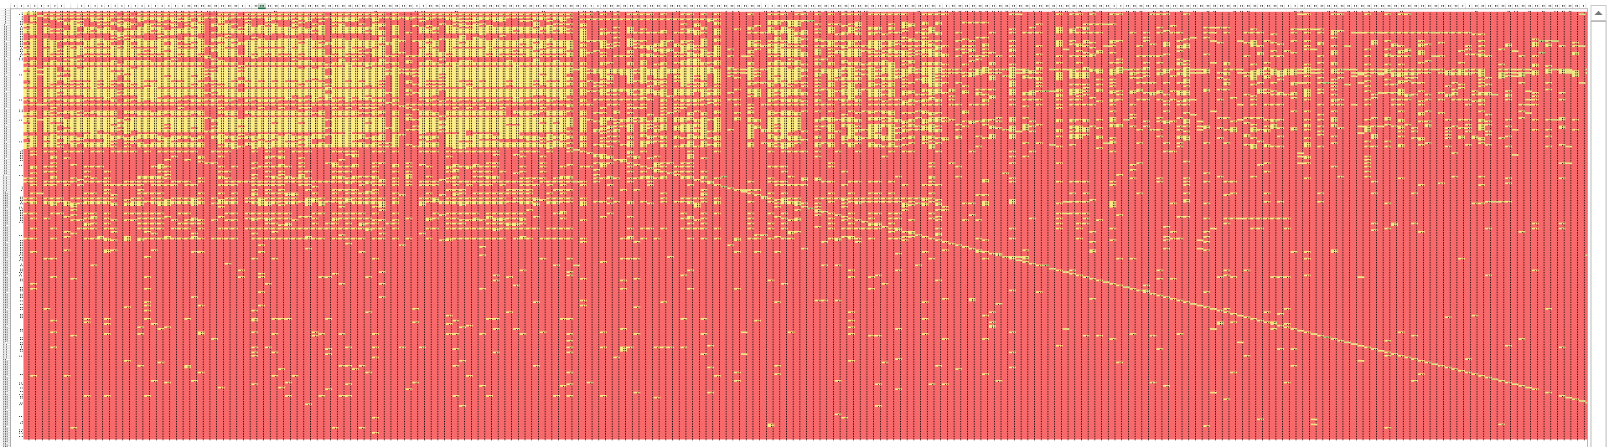
Data Understanding
In this density map indicates that a high volume of cab rides are happen within the same taxi zones.
The other high volume of commute is happening between Manhattan to Queens followed by Bronx and then Brooklyn and State Island being the least.
We see the same pattern even in the Markov Transition Matrix where people tend to travel within the same Geo Location.
Markov Transition Matrix

Slide 12
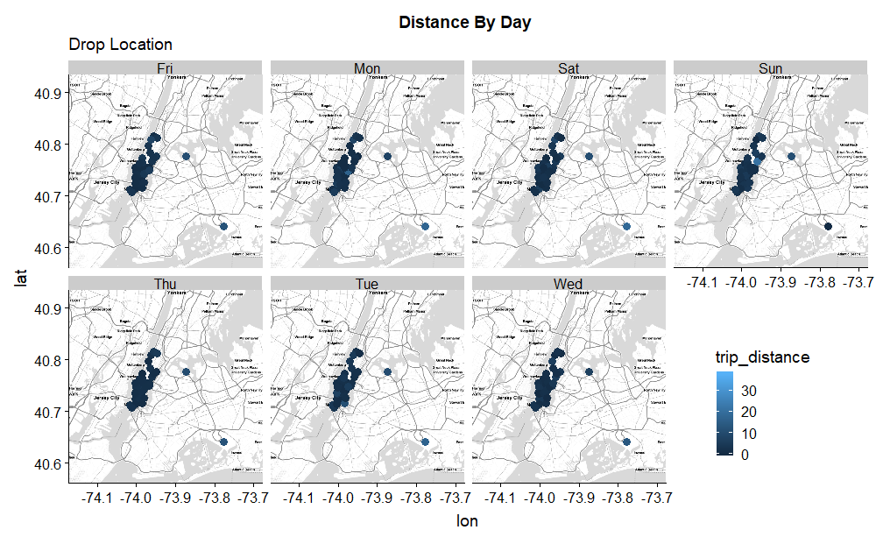
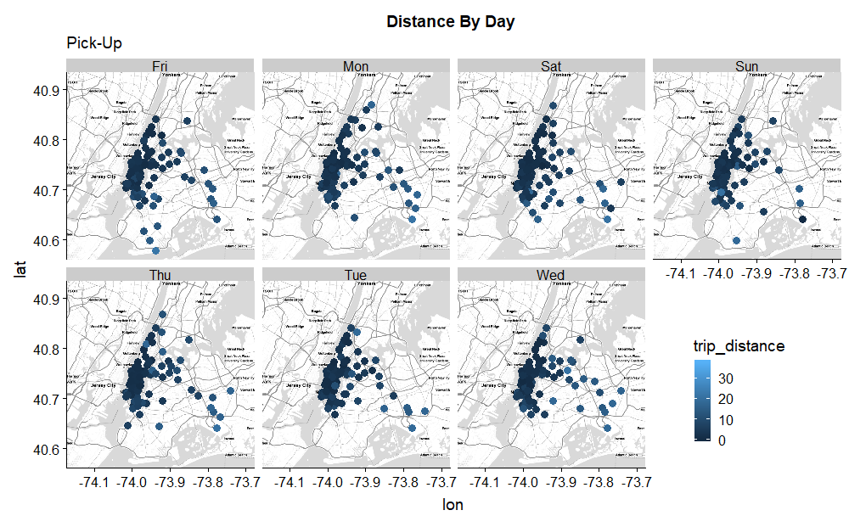
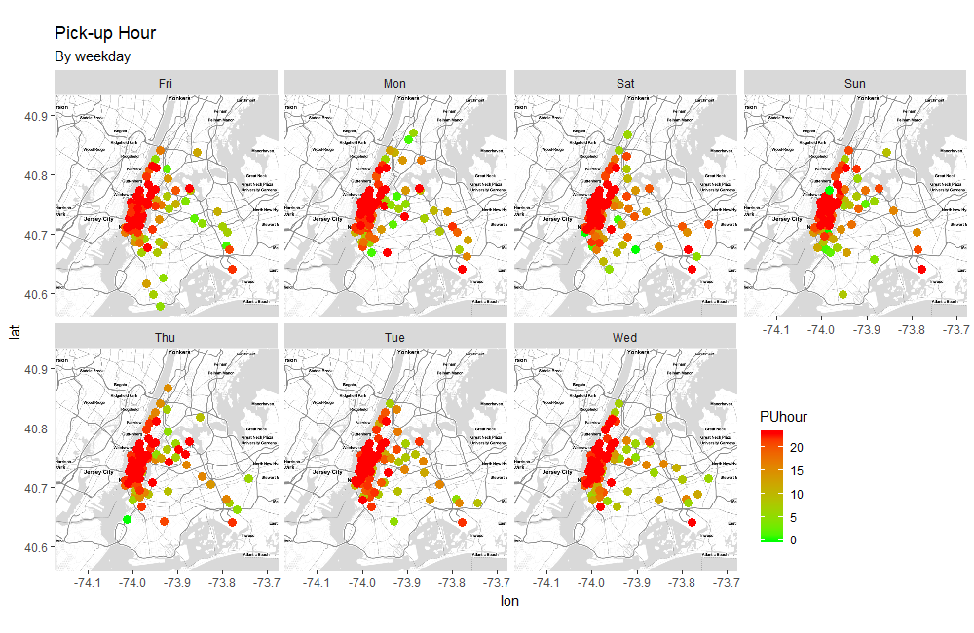
Data Understanding
Most of the Drops are concentrated towards Manhattan
The trips at Manhattan mainly happens at night.

Slide 13
Data Preparation
How did we make this happen?
One of the key component of the dataset was to introduce geolocation to make the most of geo tag analysis.
In the latest few months the NYC Taxi cab data have changed their formats and have stopped sharing the geo location of evert pick and drop but share zones instead.
There is no other variable that would point at the exact location or we could impute from the duration of the cab since the direction of the cabs trajection is unknown.
Hence we settled with the zone latitude and longitude so that we can understand the volume of the traffic.
We also made use of the time variables to compute day of travel and duration of the travel.

Slide 14
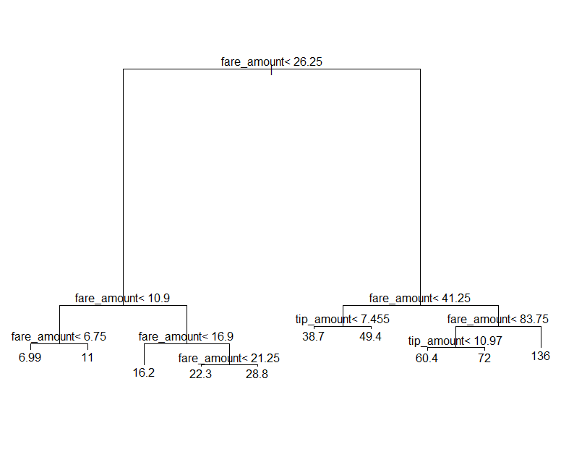
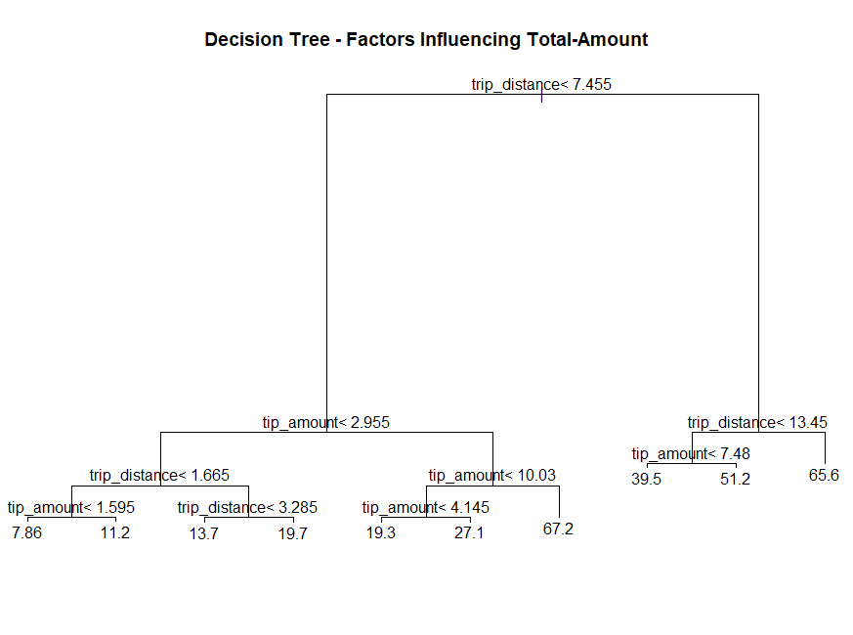
Modeling – Decision Tree
Decision Tree : The Fare amount contributes to 80% of the total fare amount hence it is not surprising when the Fare amount was selected as an important feature in predicting the Total Fair.
Hence we took out Fare Amount and derived a second decision tree

Slide 15
Modeling – Markov Chain
The Markov Chain helps us estimate the volume of demand by zones with the help of the Transition Probability Matrix.
Since we know from the EDA that public tend to travel within the same taxi zone, it becomes important to estimate demand by zones.
We have estimated the demand to increase by 11% in July bringing up the revenue to $16,41,206.
The Markov Chain enables us to estimate demand to the nth level i.e. by days of week, by date and by Hour, without worrying about over fitting the model. We are able to estimate demand from one state to another.

Slide 16
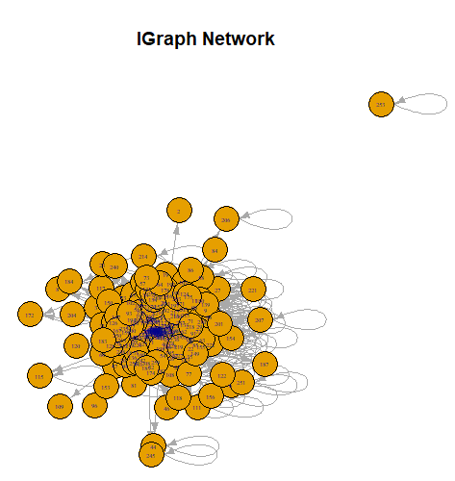
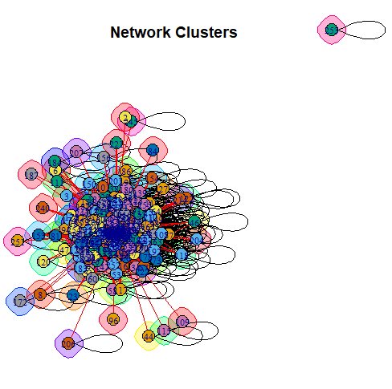
Modeling
Network Analysis
We made use of Igraph to draw the network and see the number of nodes and edges from each geo location.
With the help of community detection we tried to cluster each zones so that products can be designed for these specific clusters of zones.
Willets Point
(Queens)
Industrial Area

Slide 17
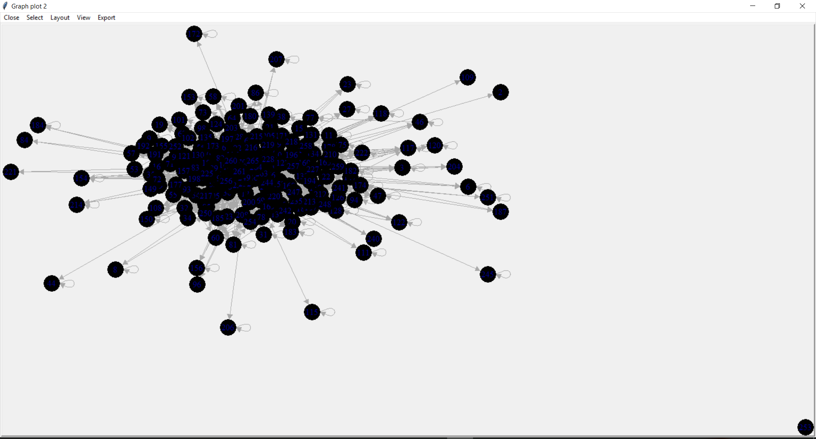
Modeling
Network Analysis (Tkplot)
The earlier networks were extremely difficult to understand and interpret from. Hence with the help of TK plot we could create an interactive network so that we can understand the relationship between nodes and the edges connecting them.
With this application we were even able rotate the network enabling us to see every possible connection in real time.

Slide 18
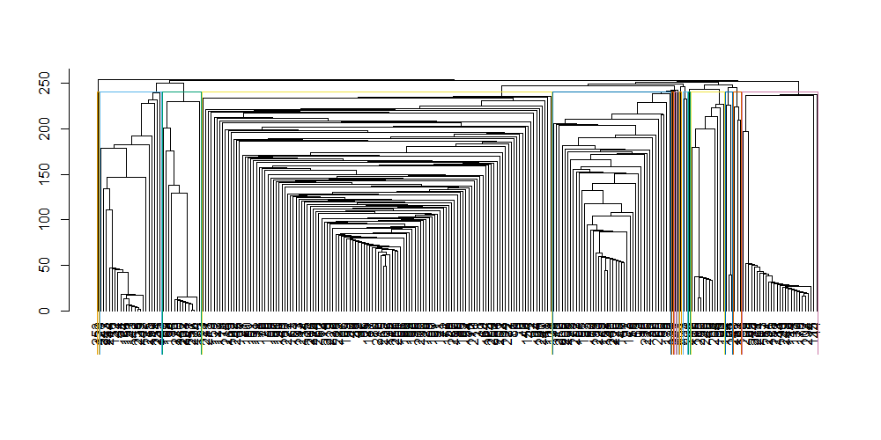
Modeling
The network model suggested 15 clusters of Taxi Zones which would be very difficult to manage.

Slide 19
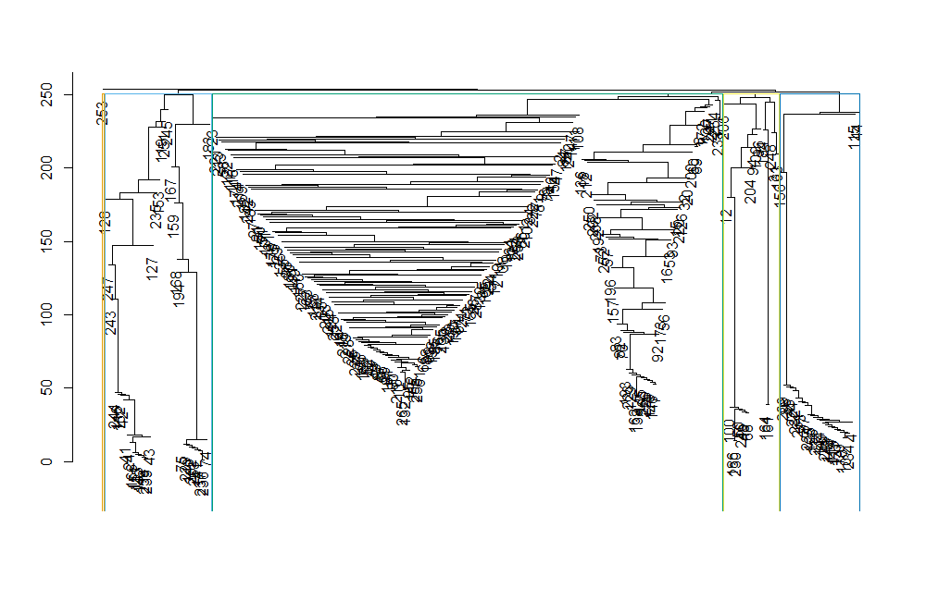
Modeling
Based on the weight of each node and edge we were able to build the following 6 clusters for the NYC Taxi.

Slide 20
Executive Summary
Message – What did we discover?
Message – What do we recommend?
One of the key points we discovered in the dataset is that majority of the cabs circle within a single taxi zones, very rarely do they move from one zone to another, hence it would be easier to manage demand by zones.
Fare cabs are normally used for short distance and commute that takes less time (AVG Fare Price is 14$).
Most of the commute happens in the night time not during the day time, hence it in intuitive why people prefer taking single passenger trips and not shared drive.
We also noticed that the Number of passengers in the cab varies by the day in the week.
On Monday to Thursday: Manhattan & Financial district is densely covered by cabs transporting 1-2 passengers
On Friday to Sunday : The number of passengers per trip increases over the weekend.
Most of the drop location is towards Manhattan & both NYC Airport
Based on the network and the number of edges we were able to identify 5 distinct clusters also known as community clusters of a network.
Based on the observations we would like to propose the following:
Creating shared taxi for week days particularly in the Manhattan Zone.
Increase the frequency of shared cabs within the same taxi zones, why we don’t recommend shared traveling is because these are mostly might night travel and customers may not feel safe sharing their cabs at night.
Introduce shuttle bus to accommodate more than 6 passengers to ensure more people are transported to Financial District and Lower Manhattan, hence reducing road congestion.
Offer lower taxi fares from Friday to Sunday to Bronx, Brooklyn and State Island to induce more demand over the weekend.
Frequency of Cabs should be increase for Airport Travel as demand is estimated to increase in these 2 zones “JFK Airport ” & “LaGuardia Airport”

Slide 21
The end

